Slide 1
FuSa Security Requirements
Roberto Paccapeli, Maurizio Iacaruso

Slide 2

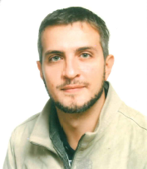
Speakers
Ph.D R. Paccapeli
Role / Skill set: Intel Functional Safety Manager
Division: IOTG PMCE FSS (Italy)
Background: Acting today as Functional Safety Manager, Roberto supports the planning and coordination of INTEL safety programs. He achieved the Doctorates in “Mathematical Methods Applied to Science” (University of Rome Sapienza) and in “Mechanics” (University of Paris VI) in 2011. He is member of the Italy-task forces involved on ISO 26262 (as of 2015) and IEC 61508 (as of 2020) standards. As of 2019, he is part of ELISA (Enabling Linux in Safety Applications) project, hosted by Linux Foundation. Currently, and leads FuSa LC MRC member, internal Intel group responsible to establish, implement and maintain FuSa Lifecycle in compliance with safety standards. He is part of ELISA Project Enabling Linux In Safety-Critical Systems
Email: roberto.paccapeli@intel.com
M. Iacaruso
Role/ Skill set: Functional Safety Software Architect
Division: IOTG PCME FSS
Background: Acting today as Functional Safety Software Architect for Internet of Things Intel products. He is part of ELISA Project Enabling Linux In Safety-Critical Systems, a Linux Foundation open source project. Graduated in Computer Engineering in 2015 at University of Pisa (Italy)
Email: maurizio.iacaruso@intel.com

Slide 3
Industry 4.0 as a great opportunity
INDUSTRIAL
AUTOMOTIVE
TRANSPORTATION
AVIONICS
Industrial Market is driven by regulations mandating functional safety:
Robotics: Human-Robot collaboration
Programmable logic controller (PLC)
Industrial PCs
Advanced multifuction controller
HMI: Remote monitoring and control
Workload consolidation
Many functions provided by automotive market require Functional Safety applications up to ASIL D at system level:
Instrument cluster
Rear-view camera
Surround-view system
Safety-related audio chimes
Computer Vision Algorithm (Driver Monitoring)
Central vehicle applications
Transportation Systems are undergoing a digital transformation that requires an increased demand for higher levels of safety:
Passenger Information Systems
Fleet Management
e-ticketing
Passenger Infotainment
Traffic Monitoring
Signaling Systems
Passenger Boarding Sensors
Avionics market is approaching complex multi core SoC systems to support several use cases:
Glass Cockpit
Flight Navigation
Flight Communications
Flight Controls
Engine Controls
In-Flight Entertainment
Electr. & emergency

Slide 4
Industry 4.0: Key Enabling Technologies (KET)
Identification, Tracking & Transport
Big Data Analytics
Next-GEN Sensors
Human Interface
Maintenance Decision Support System (MDSS)
Supervisory Control and Data Acquisition (SCADA)
IoT
Radio Frequency Identification (RFID) & Real Time Location Systems (RTLS)
Manufacturing
Maintenance Decision Support System (MDSS)
Autonomous Vehicles
Augmented Reality (RA)
Energy Efficient Technology (Energy Harvesting, Renewable Energy)
Collaborative Robots (COBOTS)
Artificial Intelligence & Machine Learning
Security, Safety & Service
Cloud Computing
Cyber Security
QoS-Functional Safety
Collaborative Platforms
Product Development Decision Support System (PD-DSS)
Digital Twin (to connect monitoring and management systems)
Cyber Physical Systems
Human Machine Interface (HMI)
Manufacturing Execution & Management System (MEMS)
Application
Computation
Transmission
Perception
IoT Layers
Functional Safety (FuSa) standards like ISO 26262 and IEC 61508 are providing requirements and guidelines for a complete FuSa SW lifecycle.

Slide 5
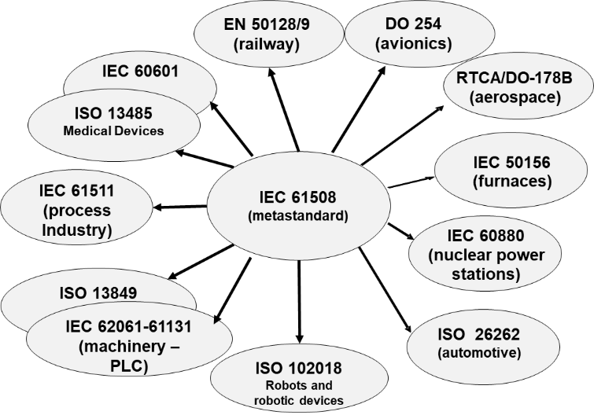
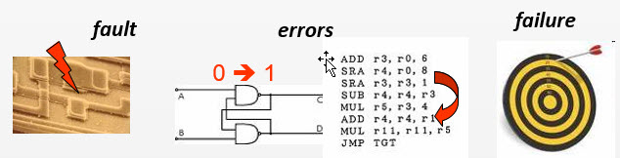
What is Functional Safety?
“The Absence of Unreasonable risk due to hazards caused by
malfunctioning behavior of E/E systems”
Objective: Freedom from unacceptable Human Risk/Damage either directly or indirectly
Aiming to Detect / Control / Prevent Failures
Fault: abnormal condition on your design that potentially could cause an element or an item to fail
Error: discrepancy on your “data” path (i.e. computed / observed values versus expected values)
Failure mode: how the failed function appears outside the module
Hardware Random Failures
Systematic Failures

Slide 6
Functional Safety and Communication Challenges
“The Absence of Unreasonable risk due to hazards caused by
malfunctioning behavior of E/E systems”
Objective: Freedom from unacceptable Human Risk/Damage either directly or indirectly
Energy & Range (Attenuation)
Functional Security
Adjacent Channel & Inter Channel Interference (Corruption)
Challenges
Bit Rate & Bandwidth (BER)
Functional Safety
Channel Noise (SNR)
IEC 61784-3
Functional Safety communication profiles

Slide 7
Functional Safety and Communication Challenges
Hazards and Safety Mechanisms Mapping
Hazop Word | Types of Failure Modes | Safety mechanisms
 |  | Sequence number | Content-check at defined time point | Check based on time frame | Authentication | Check the confirmed reception | Check data Integrity | Redundancy with cross checking | Different data integrity assurance system
Other than | Corrupted messages |  |  |  |  | X | X | X
More | Unintentionally repetition of messages | X | X |  |  |  |  | X
Part of | Out-of-sequence errors | X | X |  |  |  |  | X
No | No message received | X |  |  |  | X |  | X
Early / Late | Delayed message |  | X | X
More | Unknown message | X | X |  | X | X |  | X
More | Masquerade or incorrect addressing of information |  |  |  | X | X |  |  | X

Slide 8
Functional Safety and Security Challenges
NOTE (Ref.): IoT Layers with Major Security Threats are extracted from: https://www.researchgate.net/publication/330662605_Deployment_of_IoT_based_smart_environment_Key_issues_and_challenges
“The Absence of Unreasonable risk due to hazards caused by
malfunctioning behavior of E/E systems”
Objective: Freedom from unacceptable Human Risk/Damage either directly or indirectly
IoT Layers with major Security threats
Computation Layer
Application Layer
Perception Layer
Network Layer
Spoofing
Signal/Radio Jimming
Node Capturing
Node Outage
Device Tampering
Selective Forwarding
Sybil Attack
Sinkhole Attack
Hello-Flood Attach
Data Tampering
DoS Attack
Unauthorized Access
Sniffers/ Loggers Attack
Injections
Session Hijacking
Example: https://securityintelligence.com/eight-crazy-hacks-the-worst-and-weirdest-data-breaches-of-2015/
In July, a team of researchers was able to take total control of a Jeep SUV using the vehicle’s CAN bus.
ISO/SAE 21434
Road vehicles — Cybersecurity engineering

Slide 9
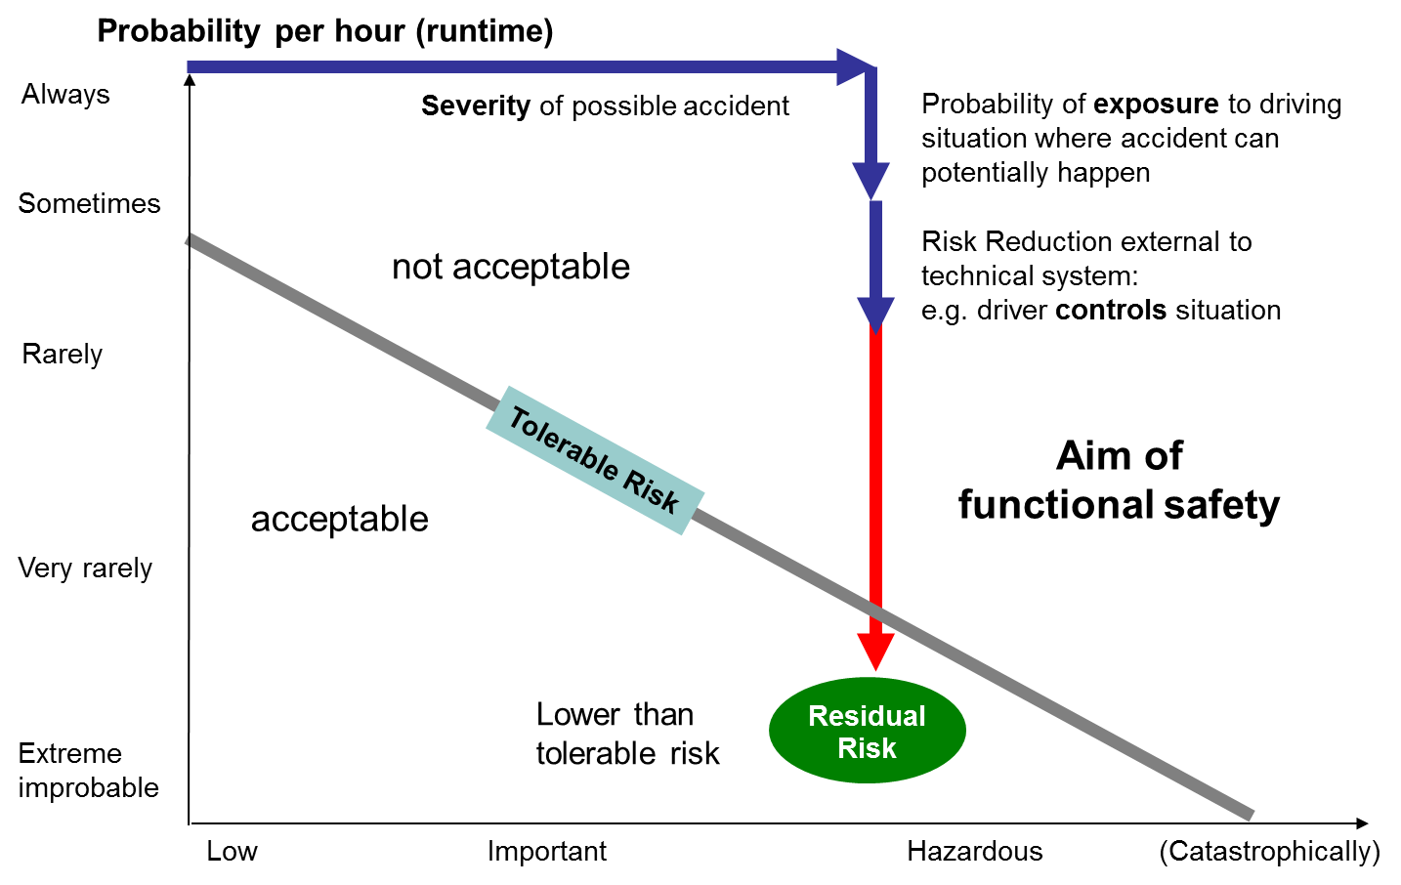
Hazard Analysis and Risk Assessment
HARA analysis:
RISK ASSESSMENT
Tolerable Risk = Severity x Occurrence
S
Exposure x Controllability
req. ASIL
ISO 26262 | Target | Applications example
ASIL D | 99% | Brake-by-wire, EPS, ESCL, etc.
ASIL C | 97% | Battery management for hybrid vehicle
ASIL B | 90% | Automotive dashboard, stop lights
ASIL A | 60% | Rear lights
E
C

Slide 10
Safety and Security Requirements
TARA
HARA
has a value for
Owner
Asset
Define the safety item
with regard to
has
with risk of
Determine features to realize safety item
Attacker
Attack Potential
Threat
for execution of
reduced by
Determine malfunctions of functions
Malicious Action
Security Goal
performed at
Determine operational scenarios
Point of Attack
Identify possible hazards
(effects)
The intersection between security and safety requires:
Analysis of security threads affecting safety
Consideration of security measures helping safety
Protecting safety measures if vulnerable points for attacks
Adding safety measures helping security
Evaluate the ASIL and determine the safety goals

Slide 11

Safety and Security: Flows Interceptions
Functional Safety Flow
Security Flow
Unified Flow
1
Definition of concept
2
Safety scope and definition
5
Definition of security environment
3
Hazard Analysis and Risk Assessment (HARA)
6
Threat Analysis and Risk Assessment (TARA)
4
Safety requirements
9
Overall Hazard and Risk Analysis
7
Security objectives
10
Safety/Security requirements
8
Security requirements
11
Safety/Security requirements allocation

Slide 12
A wide space of solutions and interpretations
OEM
Supplier
FUNCTIONAL SAFETY CONCEPT
TECHNICAL SAFETY CONCEPT
System level safety based on Off The Shelf components and safety monitors
Diverse or homogenous combination of safety capable components
Single safety capable component plus fall back

Slide 13
ASIL Decomposition approach
Solution: combination of ISO 26262 methods
Qualification approach (ISO26262-8§12)
Combination of legacy components by using ASIL decomposition (ISO26262-8§9.5).
Benefit:
Same set of safety requirements is allocated to the HW / SW COTS and to the separate, independent safety monitor;
Generation of the minimum set of evidences / collaterals against the overall Safety Integrity Level;
Not required the application of standard-related requirements retroactively to a design already in production;
Not required the application of changes on HW / SW COTS to meet ASIL target that could impact other requirements like e.g. performance
Technical Safety Concept
QM
ASIL D
QM
QM(D)
QM(B)
ASIL D(D)
ASILB(D)
ASILD(D)
ASILB(B)
ASILB(D)
ASIL B
Non safety related function
Decomposed safety related function
ASIL monitoring function
Final voting function

Slide 14
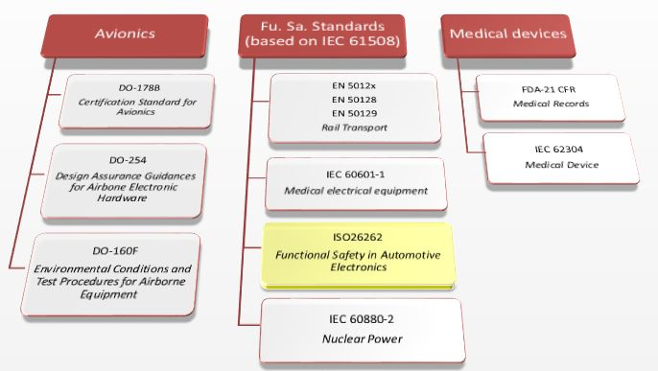

How to build robust “process” argumentation
A-S-I-L ?
Safety Package
User Guide
Safety Manual
Safety Report
Technical Safety Concept
System Validation & Testing
Safety Analysis
Type of analysis | ASIL A | ASIL B | ASIL C | ASIL D
Approach 1 | ++ | ++ | ++ | ++
Approach 2 | + | + | ++ | ++
Principles for designs | ASIL A | ASIL B | ASIL C | ASIL D
Best Known Method 1 | ++ | ++ | ++ | ++
Best Known Method 2 | + | + | ++ | ++
Best Known Method ... | + | ++ | ++ | ++
Best Known Method n | + | + | + | +
Safety Requirements
Platform Testing
Test case generation | ASIL A | ASIL B | ASIL C | ASIL D
Method 1 | ++ | ++ | ++ | ++
Method 2 | + | + | ++ | ++
Method ... | + | ++ | ++ | ++
Coverage metrics | ASIL A | ASIL B | ASIL C | ASIL D
Technique 1 + target | ++ | ++ | ++ | ++
Technique 2 + target | + | + | ++ | ++
Technique ... + target | + | ++ | ++ | ++
Technique n + target | + | + | + | +
HW / SW / FW design specification
Module Integration Testing
Implementation

Slide 15
How to build robust “process” argumentation
BENEFIT FROM RED- and BLUE BOXES:
Maximize the cross-standard compliancy it is essential
Apply the most conservative approach in case of different targets
Maintain the sufficient flexibility to leverage on existing techniques as much as possible usable to populate the Safety Case
Produce a superset of collaterals required by Functional Safety Standards
Green-box: Connected with Technical Safety requirements (type of safety function to be implemented; allocation to architectural design elements; environment definition; configuration definition; any other system level constraints and features)
Safety Package
User Guide
Safety Manual
Safety Report
Technical Safety Concept
System Validation & Testing
Safety Analysis
Safety Requirements
Platform Testing
HW / SW / FW design specification
Module Integration Testing
Blue-box: FuSa process requirements are defined to target the standard quality measures / properties
Red-box: FuSa process requirements are defined to target rules extracted from safety standards
Implementation

Slide 16
Risk assessment based on static code analysis
User Space
Issues with impact on intended safety functionalities:
Safety: Presences of bugs (“systematic faults”) could lead malfunctioning behaviour of implemented features (“failure modes”)
Security: External attackers could take advantages on the presence of security weaknesses in the code that could lead vulnerabilities
Off-The-Shelf components
WEAKNESS
BUG
Hardware
Functional safety directly addresses issues resulting from bugs that could lead failure modes and it provides guidance on possible interaction with Cybersecurity (that addresses issues resulting from malicious intent external to the E/E system).
The current state-of-the art suggests to take advantage to show the highest quality of code by performing risk assessment against:
MISRA 2012 or more to justify the avoidance of bugs (or at least their prevention / mitigation). MISRA is explicitly mentioned by ISO 26262
CWE to justify the avoidance of weaknesses (or at least their prevention / mitigation).

Slide 17

HW / SW COTS as “FuSa Enabled”
Highest Quality = FuSa Enabled !!
The approach gives sufficient flexibility to make «usable» SW designs not conceived according to specific safety standards for FuSa purpose
Static analysis in conjuction with quality best practises
Formalized approach based on quality standards helps FuSa experts on collecting sufficient argumentation to justify the robustness of HW / SW COTS
Proven robustness of HW / SW COTS is a Quality target (independently from Functional Safety application)
ISO 26262
IEC 61508
FuSa
MISRA
AUTOSAR
CWE
Quality

Slide 18


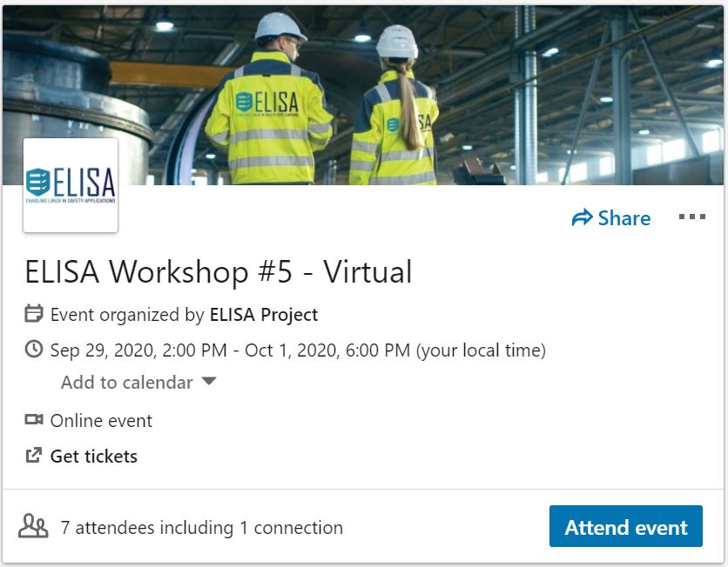
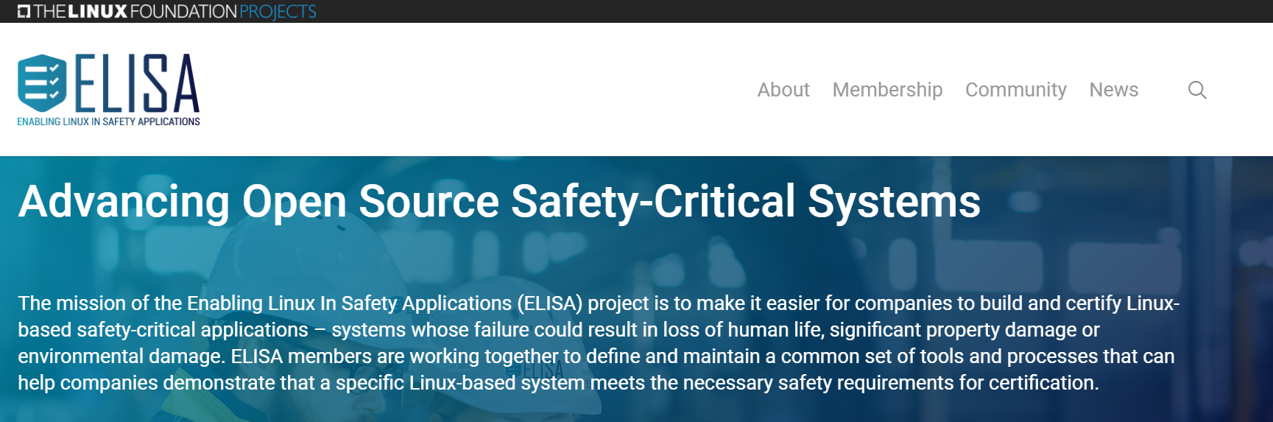
More “open” communities more synergies
https://www.cip-project.org/
Full agenda now online: https://elisa.tech/announcement/2020/08/31/elisa-workshop-5-virtual-september-29-october-1/
https://elisa.tech/

Slide 19
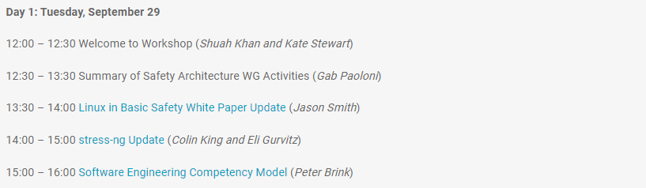
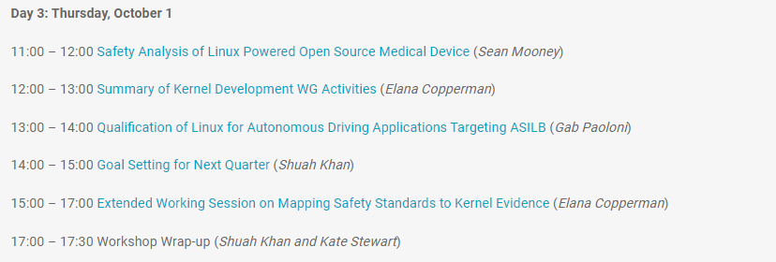
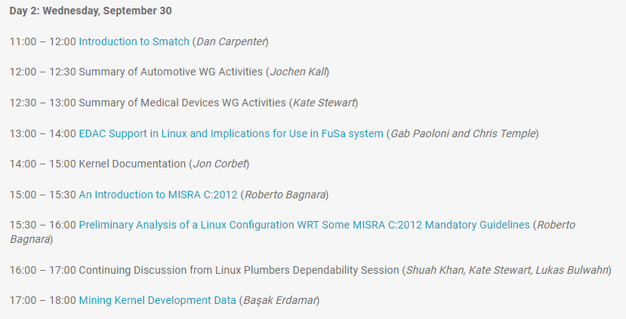
More “open” communities more synergies
ELISA Workshop #5 Virtual September 29th – October 1st
Session schedule and abstracts can be found here: https://elisa.tech/announcement/2020/08/31/elisa-workshop-5-virtual-september-29-october-1/
SAVE THE DATE!!!

Slide 20
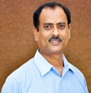
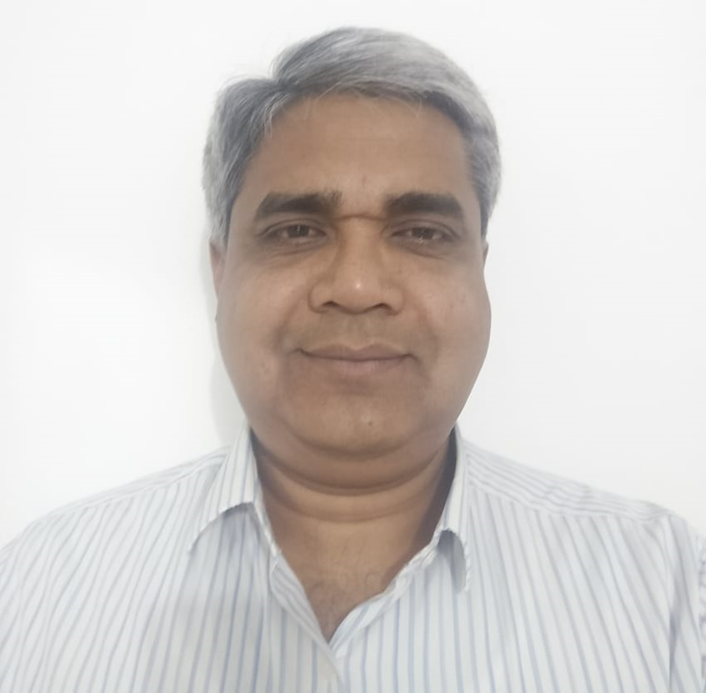
Other contributors
Prof. T.K. Ramesh
Role/ Skill set: : Associate Professor
Division: Department of ECE, Amrita School of Engineering, Bengaluru Campus
Background: Dr. T. K. Ramesh obtained his PhD from Amrita Vishwa Vidyapeetham in the field of Optical Networks. He has published over 70 research publications in peer-reviewed International Journals and Conferences. He has successfully guided three PhD’s and now he is guiding 8 – PhD scholars. His areas of research include Communication Networks and its Applications, Analog and Digital Devices and Circuits, Functional Safety, Artificial Intelligence and Network-on-chip. He has 27 years of teaching & research experience. He is a lifetime member of the Indian Society for Technical Education and The Institution of Electronics and Telecommunication Engineers.
S. Sivasubramanian (Siva)
Role/ Skill set: Quality Assurance & Reliability Engineer
Division: Global Supply Chain, Intel India, Bengaluru, & PhD Scholar Department of ECE, Amrita Vishwa Vidyapeetham, Bengaluru Campus
Background: More than 28 years of experience in the field of Aerospace Quality, Reliability, Safety Analysis. Siva is a PhD scholar in Amrita Vishwa Vidyapeetham and serving in Intel India, Bengaluru

Slide 21
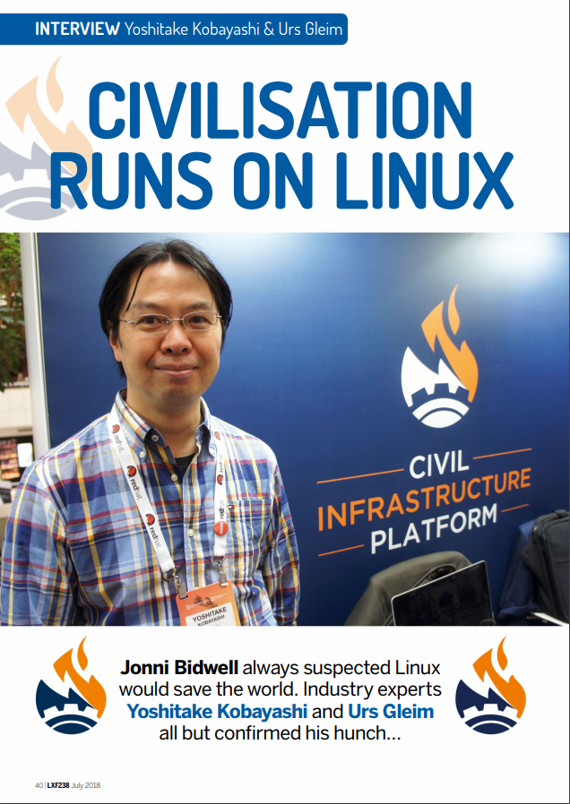
Thank you!!

Slide 22




Contact Us
The Linux Foundation
1 Letterman Drive Building D, Suite D4700 San Francisco CA 94129 Phone/Fax: +1 415 7239709 www.linuxfoundation.org
General Inquiries
info@linuxfoundation.org
Membership
membership@linuxfoundation.org
Corporate Training training@linuxfoundation.org
Event Sponsorship sponsorships@linuxfoundation.org

Slide 23
Legal Notices
The Linux Foundation, The Linux Foundation logos, and other marks that may be used herein are owned by The Linux Foundation or its affiliated entities, and are subject to The Linux Foundation’s Trademark Usage Policy at https://www.linuxfoundation.org/trademark-usage, as may be modified from time to time.
Linux is a registered trademark of Linus Torvalds. Please see the Linux Mark Institute’s trademark usage page at https://lmi.linuxfoundation.org for details regarding use of this trademark.
Some marks that may be used herein are owned by projects operating as separately incorporated entities managed by The Linux Foundation, and have their own trademarks, policies and usage guidelines.
TWITTER, TWEET, RETWEET and the Twitter logo are trademarks of Twitter, Inc. or its affiliates.
Facebook and the “f” logo are trademarks of Facebook or its affiliates.
LinkedIn, the LinkedIn logo, the IN logo and InMail are registered trademarks or trademarks of LinkedIn Corporation and its affiliates in the United States and/or other countries.
YouTube and the YouTube icon are trademarks of YouTube or its affiliates.
All other trademarks are the property of their respective owners. Use of such marks herein does not represent affiliation with or authorization, sponsorship or approval by such owners unless otherwise expressly specified.
The Linux Foundation is subject to other policies, including without limitation its Privacy Policy at https://www.linuxfoundation.org/privacy and its Antitrust Policy at https://www.linuxfoundation.org/antitrust-policy. each as may be modified from time to time. More information about The Linux Foundation’s policies is available at https://www.linuxfoundation.org.
Please email legal@linuxfoundation.org with any questions about The Linux Foundation’s policies or the notices set forth on this slide.

